Slide 1
CMP 2203
Lecture 8

Slide 2
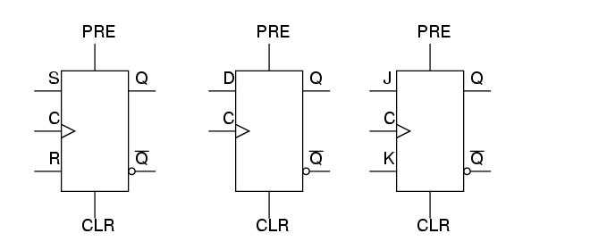
Asynchronous Flip Flops
The normal data inputs to a flip flop S, R, J&K, D and T are referred to as synchronous inputs because they have effect on the outputs (Q and not-Q) only in step, or in sync, with the clock signal transitions.
Asynchronous inputs are called preset and clear because they can set or reset the flip-flop regardless of the status of the clock signal. Symbols;
Source : Brown 3rd Edition

Slide 3
Asynchronous Flip Flops
When the preset input is activated, the flip-flop will be set (Q=1, not-Q=0) regardless of any of the synchronous inputs or the clock. When the clear input is activated, the flip-flop will be reset (Q=0, not-Q=1), regardless of any of the synchronous inputs or the clock.
if both preset and clear inputs are activated we get an invalid state on the output, where Q and not-Q go to the same state, the same as the S-R latch!
Preset and clear inputs find use when multiple flip-flops are ganged together to perform a function on a multi-bit binary word, and a single line is needed to set or reset them all at once.

Slide 4
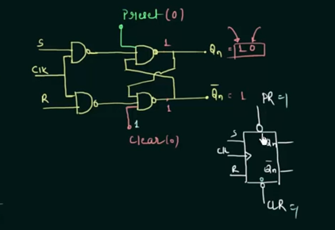
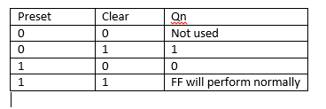
Asynchronous Flip Flops
Truth Table
Example of SR flip flop with preset and clear inputs

Slide 5
Timing Constraints
Registers (D-FF) are used in digital circuits because of the advantages;
1. Synchronise all activities to a clock signal
2. Isolate different part of the digital systems between registers-registers block the signal until the next active edge of the clock
3. Make timing consideration much easier to handle

Slide 6
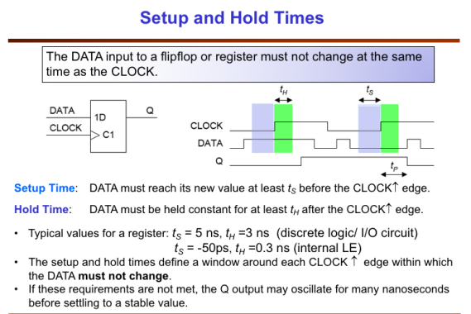
Timing constraints

Slide 7
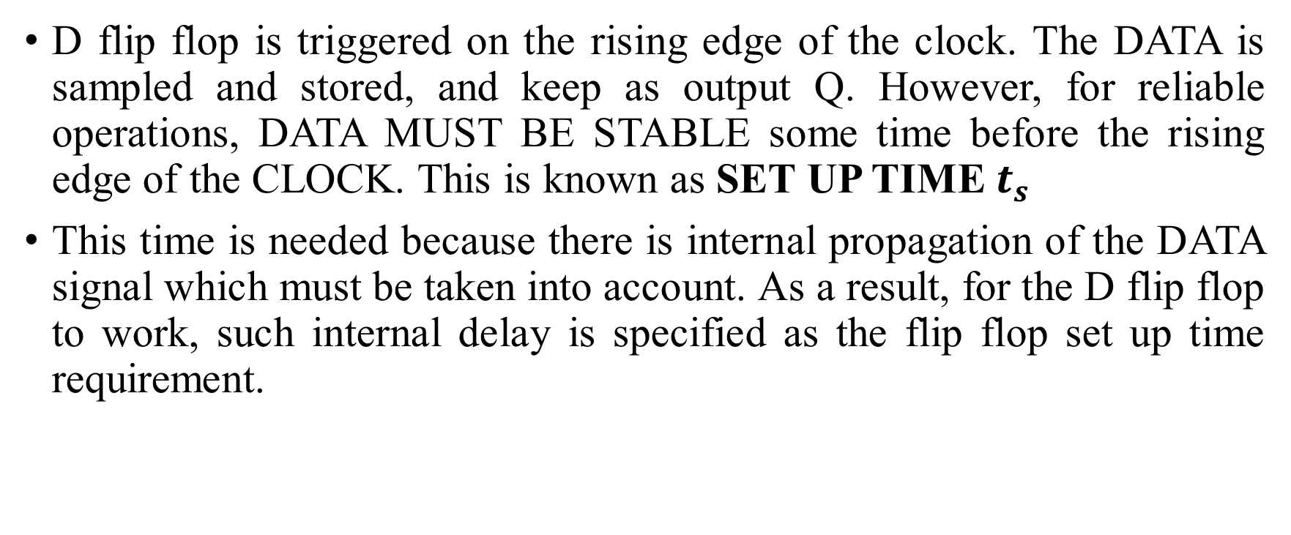
Timing constraints
D flip flop is triggered on the rising edge of the clock. The DATA is sampled and stored, and keep as output Q. However, for reliable operations, DATA MUST BE STABLE some time before the rising edge of the CLOCK. This is known as SET UP TIME $t_{s}$
This time is needed because there is internal propagation of the DATA signal which must be taken into account. As a result, for the D flip flop to work, such internal delay is specified as the flip flop set up time requirement.

Slide 8
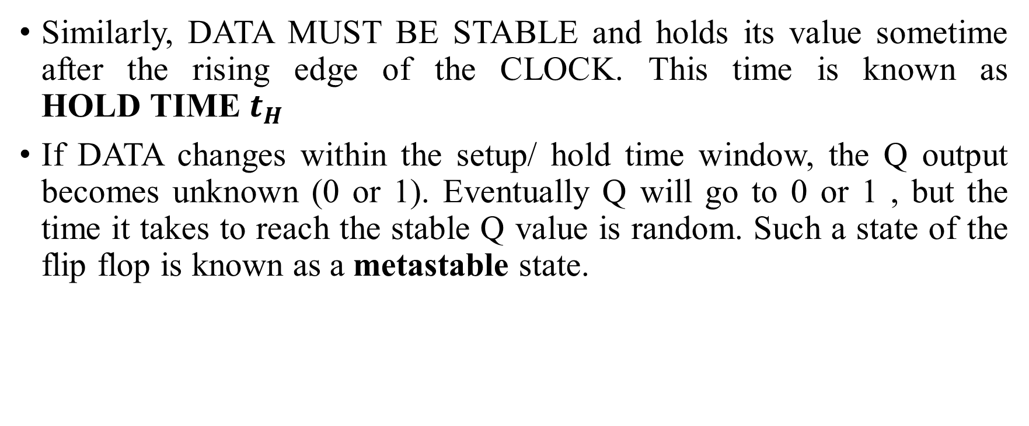
Timing constraints
Similarly, DATA MUST BE STABLE and holds its value sometime after the rising edge of the CLOCK. This time is known as ${\text{HOLD} \text{TIME} t}_{H}$
If DATA changes within the setup/ hold time window, the Q output becomes unknown (0 or 1). Eventually Q will go to 0 or 1 , but the time it takes to reach the stable Q value is random. Such a state of the flip flop is known as a metastable state.

Slide 9
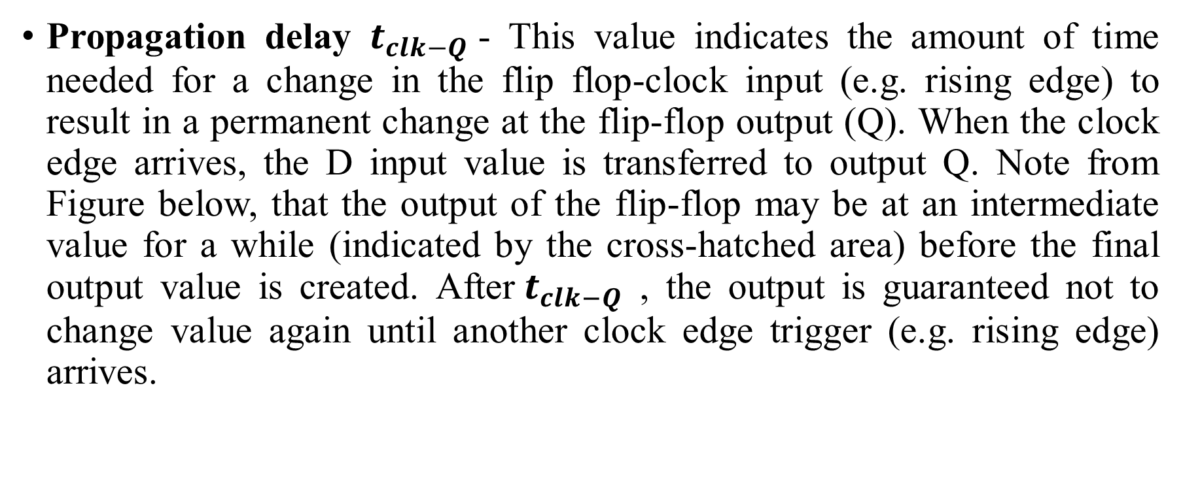
Timing constraints
Propagation delay $t_{clk−Q}$- This value indicates the amount of time needed for a change in the flip flop-clock input (e.g. rising edge) to result in a permanent change at the flip-flop output (Q). When the clock edge arrives, the D input value is transferred to output Q. Note from Figure below, that the output of the flip-flop may be at an intermediate value for a while (indicated by the cross-hatched area) before the final output value is created. After${ t}_{clk−Q}$ , the output is guaranteed not to change value again until another clock edge trigger (e.g. rising edge) arrives.

Slide 10
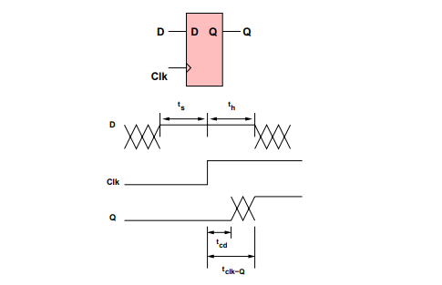
Propagation delay
Source : Google images

Slide 11
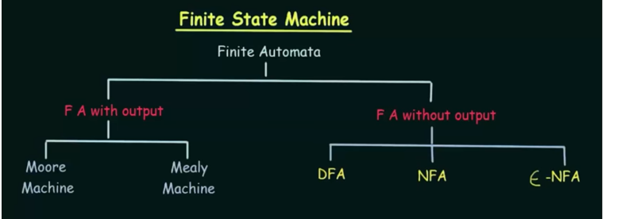
Finite State Machines
Finite State machines (FSM) are also called Finite automata and may have outputs corresponding to each transition. There are two types of finite state machines that generate output −
• Mealy Machine
• Moore machine
Source : Google Images

Slide 12
Moore Machines
Moore machine is an FSM whose outputs depend on only the present state.
The advantage of the Moore model is a simplification of the behaviour. Consider an elevator door. The state machine recognizes two commands: "command_open" and "command_close", which trigger state changes. The entry action (E:) in state "Opening" starts a motor opening the door, the entry action in state "Closing" starts a motor in the other direction closing the door. States "Opened" and "Closed" stop the motor when fully opened or closed. They signal to the outside world (e.g., to other state machines) the situation: "door is open" or "door is closed".

Slide 13
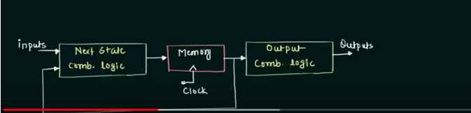
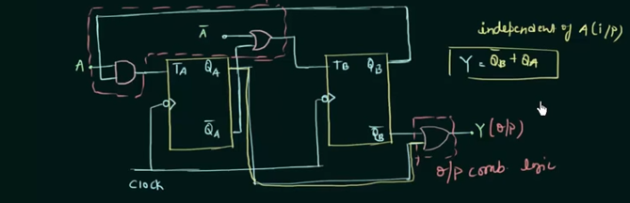
Moore Machines

Slide 14
Mealy Machines
A Mealy Machine is an FSM whose output depends on the present state as well as the present input.
The use of a Mealy FSM leads often to a reduction of the number of states. See same example of elevator as discussed in Moore machines; There are two input actions (I:): "start motor to close the door if command_close arrives" and "start motor in the other direction to open the door if command_open arrives". The "opening" and "closing" intermediate states are not shown.

Slide 15
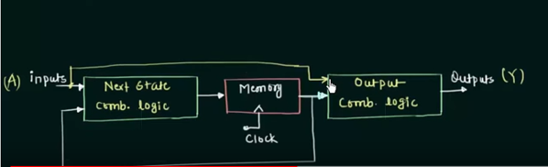
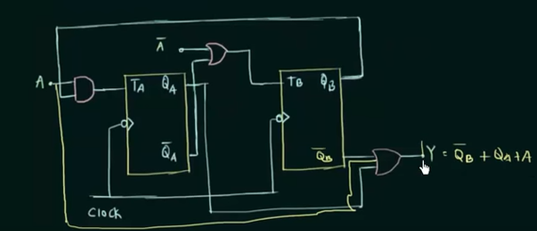
Mealy Machines
Source : Google images

Slide 16
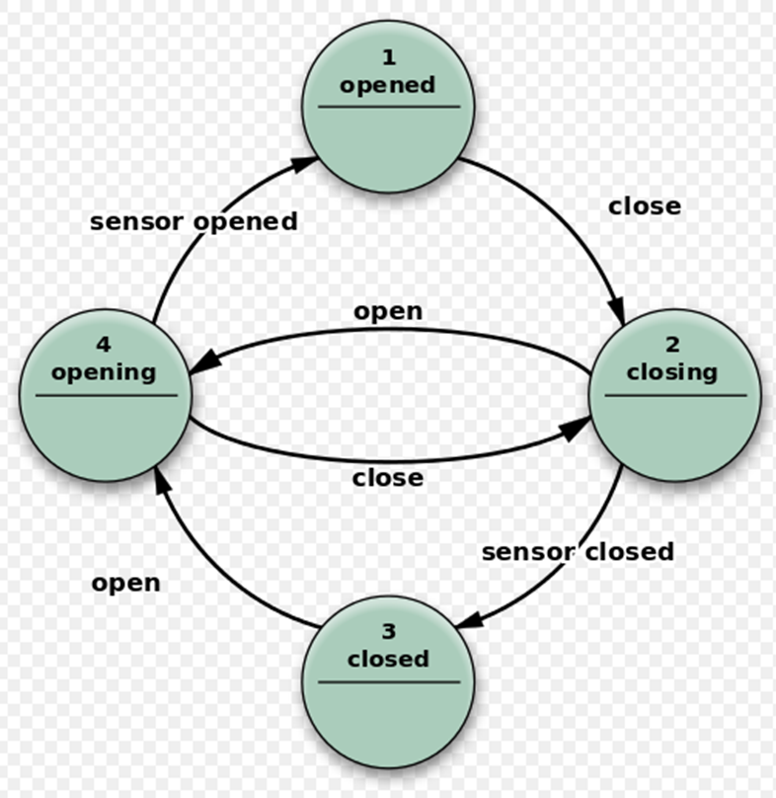
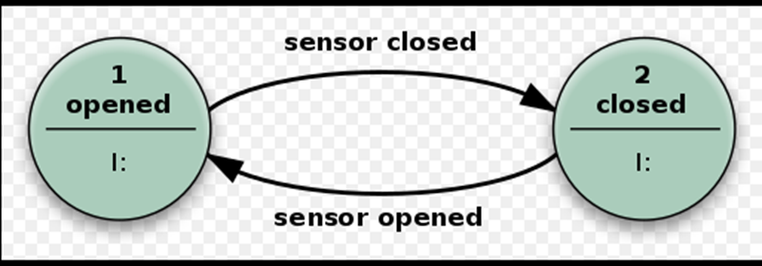
Moore Vs Mealy Example of elevator
Mealy State diagram
Moore State Diagram

Slide 17
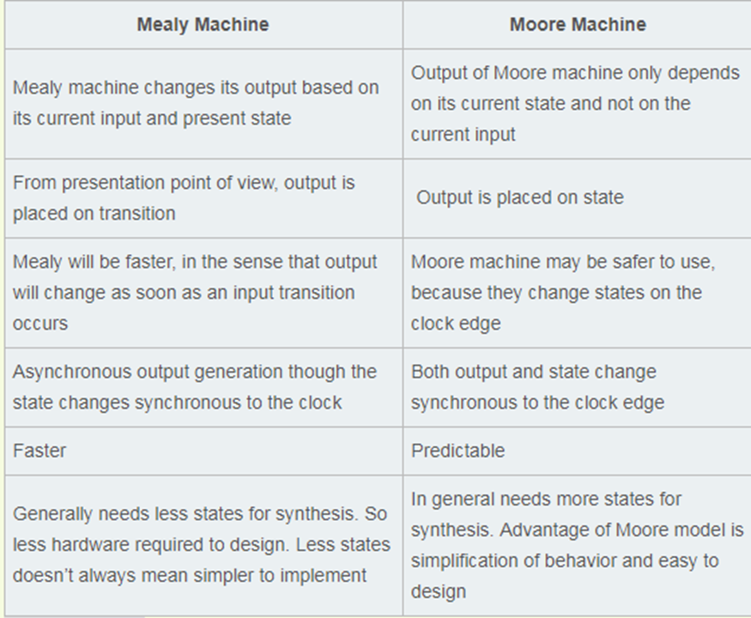
Mealy Vs Moore Machine

Slide 18
State Tables and State Diagrams
The relationship that exists among the inputs, outputs, present states and next states can be specified by either the state table or the state diagram.
State Table
The state table representation of a sequential circuit consists of three sections labelled present state, next state and output. The present state designates the state of flip-flops before the occurrence of a clock pulse. The next state shows the states of flip-flops after the clock pulse, and the output section lists the value of the output variables during the present state.

Slide 19
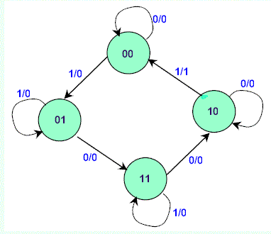
State Tables and State Diagrams
State Diagram
In addition to graphical symbols, tables or equations, flip-flops can also be represented graphically by a state diagram. In this diagram, a state is represented by a circle, and the transition between states is indicated by directed lines (or arcs) connecting the circles

Slide 20
State Tables and State Diagrams
The binary number inside each circle identifies the state the circle represents. The directed lines are labelled with two binary numbers separated by a slash (/). The input value that causes the state transition is labelled first. The number after the slash symbol / gives the value of the output. For example, the directed line from state 00 to 01 is labelled 1/0, meaning that, if the sequential circuit is in a present state and the input is 1, then the next state is 01 and the output is 0. If it is in a present state 00 and the input is 0, it will remain in that state. A directed line connecting a circle with itself indicates that no change of state occurs. The state diagram provides exactly the same information as the state table and is obtained directly from the state table.

Slide 21
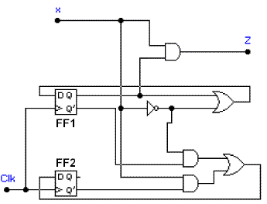
State Tables and State Diagrams
Consider a sequential circuit shown;
It has one input x, one output Z and two state variables Q1Q2 (thus having four possible present states 00, 01, 10, 11).
The behaviour of the circuit is determined by the following Boolean expressions:
Z = x*Q1
D1 = x' + Q1
D2 = x*Q2' + x'*Q1'

Slide 22
State Tables and State Diagrams
These equations can be used to form the state table. Suppose the present state (i.e. Q1Q2) = 00 and input x = 0. Under these conditions, we get Z = 0, D1 = 1, and D2 = 1. Thus the next state of the circuit D1D2 = 11, and this will be the present state after the clock pulse has been applied. The output of the circuit corresponding to the present state Q1Q2 = 00 and x = 1 is Z = 0. This data is entered into the state table as shown in table below

Slide 23
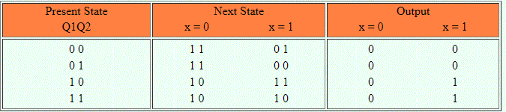
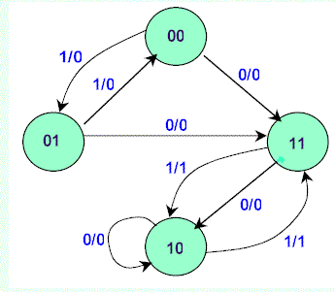
State Tables and State Diagrams
Figure showing state table
Figure showing the state diagram

Slide 24
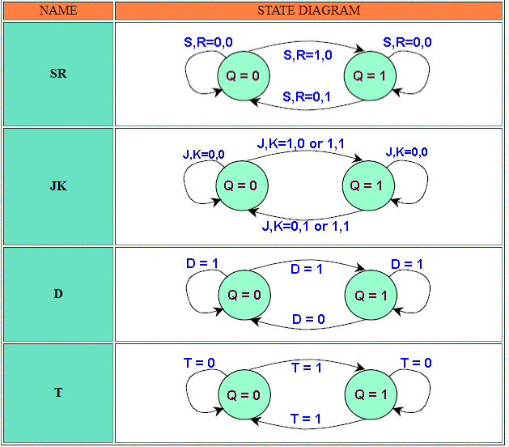
The state diagrams of the four types of flip-flops
All four flip-flops have the same number of states and transitions. Each flip-flop is in the set state when Q=1 and in the reset state when Q=0. Also, each flip-flop can move from one state to another, or it can re-enter the same state. The only difference between the four types lies in the values of input signals that cause these transitions.
A state diagram is a very convenient way to visualize the operation of a flip-flop or even of large sequential components.

Slide 25
Algorithmic state machine charts
An ASM chart is a method of describing the sequential operations of a digital system and is used in designing finite state machines.
An ASM chart consists of an interconnection of four types of basic elements: state names, states, condition checks and conditional outputs.

Slide 26
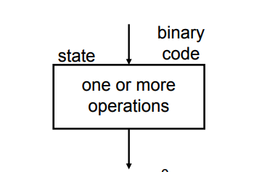
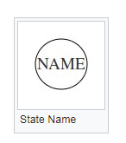
State box
State name: The name of the state is indicated inside the circle and the circle is placed in the top left corner or the name is placed without the circle.
The state box is rectangular in shape. It has at most one entry point and one exit point and is used to specify one or more operations which could be simultaneously completed in one clock cycle. The Moore-type outputs are listed inside the box. These are the outputs that depend only on the values of the state variables that define the state; we will refer to them simply as Moore outputs. It is customary to write only the name of the signal that has to be asserted. Thus it is sufficient to write z, rather than z = 1, to indicate that the output z must have the value 1.

Slide 27
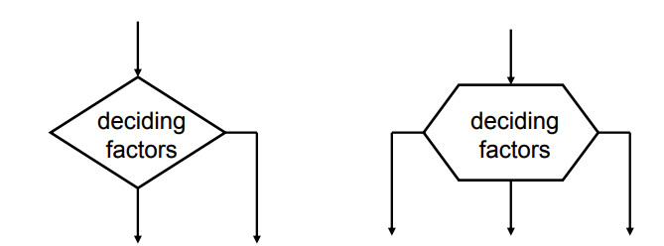
Decision box
The decision box is diamond in shape. It has one entry point but multiple exit points and is used to specify a number of alternative paths that can be followed.

Slide 28
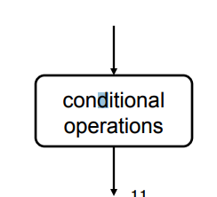
Condition box
The conditional box is represented by a rectangle with rounded corners. It always follows a decision box and contains one or more conditional operations that are only invoked when the path containing the conditional box is selected by the decision box.
An oval denotes the output signals that are of Mealy type.
These outputs depend on the values of the state variables and the inputs of the FSM; we will refer to these outputs simply as Mealy outputs. The condition that determines whether such outputs are generated is specified in a decision box.

Slide 29
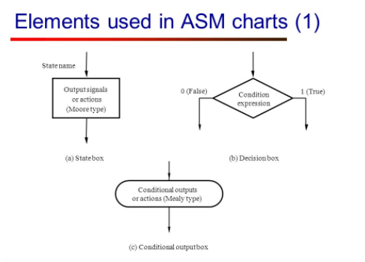
Algorithmic state machine charts
Source : Google images

Slide 30
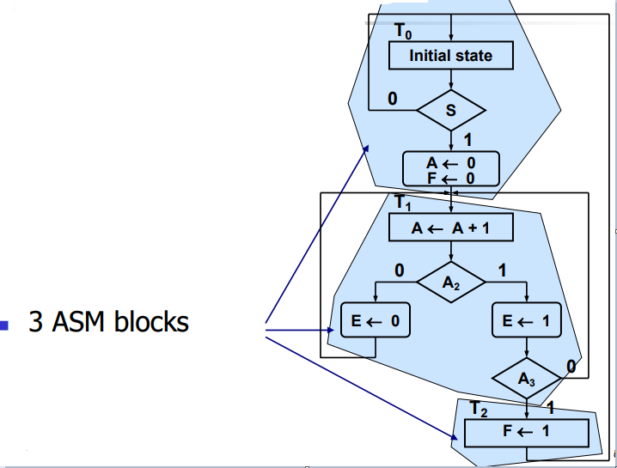
Algorithmic state machine charts
Precise timing is implicitly present in ASM
charts.
Each state box, together with its immediately
following decision and conditional boxes, occurs within one clock cycle.
A group of boxes which occur within a single
clock cycle is called an ASM block.

Slide 31
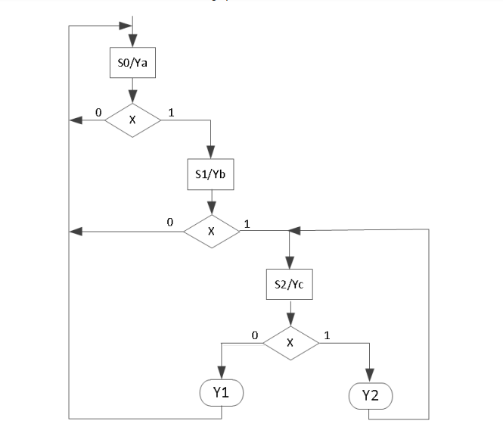
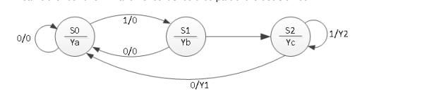
Algorithmic state machine charts
a) State diagram
b) ASM chart

Slide 32
NOTE
Read about Random Access Memory
Applications of Mealy and Moore state machines
Advantages of ASM charts

Slide 33
References
Stephen Brown, Zvonko Vranesic, Fundamentals of Digital Logic with VHDL Design, 3rd Ed, Chapter 8

